Slide 1
ML23/24-09 Approve Prediction of Multisequence Learning
Course: Software Engineering
Lecturer: Damir Dobric / Andreas Pech
Presented by:
Md. Fazley Rabbe (1502895)
Mahidul Islam Rana (1502217)
Md. Ashik Iqbal (1502569)

Slide 2
TABLE OF CONTENT
INTRODUCTION
METHODOLOGY
HTM
SPARSE DISTRIBUTED REPRESENTATION
ENCODER
SPATIAL POOLER
TEMPORAL MEMORY
IMPLEMENTATION
RESULTS
CONCLUSION

Slide 3
INTRODUCTION
Multisequence learning has a broad range of applications across multiple disciplines, such as finance, bioinformatics, natural language processing, and sensor networks. For example, MSL methods have proven crucial in computational biology to understand the intricate regulatory systems controlling genomic sequences, protein interactions, and gene expression. Similar to this, MSL models in financial markets can predict stock prices, spot trading opportunities, and better manage portfolio risks by taking use of the dependencies between various financial time series. In this project, we provide a comprehensive overview of Multisequence Learning, covering its theoretical foundations, algorithmic methodologies, and practical applications. We discuss the key challenges associated with learning from multiple sequences and highlight the unique opportunities afforded by this paradigm. Our Project can learn the previous sequence and predict the future sequence. We have trained the project and got some output It gives good accuracy

Slide 4
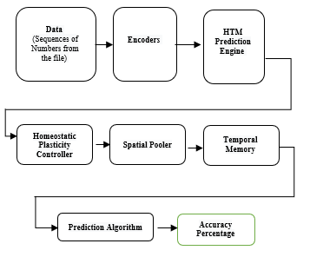
METHODOLOGY

Slide 5
ENCODER
Encoding Input Sequences : Each input sequence from different sources or modalities is encoded into a fixed-size representation by the encoder
Learning Temporal Patterns: This model learns to predict the future states of each sequence based on its past states and potentially the states of other sequences.
Training the Model: The model parameters, including those of the encoder and the predictive model, are trained using a suitable objective function, such as mean squared error (MSE) or cross-entropy loss.
Predictive Modeling: Once trained, the model can make predictions about future states of the input sequences given their past states.
Evaluation and Fine-tuning: The performance of the predictive model is evaluated on unseen data to assess its accuracy and generalization ability.

Slide 6
Hierarchical temporal memory(HTM)
Hierarchical temporal memory is a machine learning algorithm that simulates the structure and biological functionality of the neocortex and is particularly suitable for sequence learning and prediction. It not only advances our understanding of how the brain may solve the sequence learning problems but also has been applied to various practical implications, such as anomaly detection, discrete and continuous sequence modelling, face classification, handwritten digits recognition, and sequence prediction.
SPARSE DISTRIBUTED REPRESENTATION (SDR)
Encoding Input Sequences
Learning Temporal Patterns
Predictive Modeling
Multi-Sequence Learning

Slide 7
SPATIAL POOLER
The SP is a sparse feature detector that learns the common spatial patterns in a region's input and, at every time step, produces a sparse distributed representation (SDR) of the current input. It has been extended from the original algorithm into the Augmented Spatial Pooler (ASP)that is capable of handling non-binary input, multiple channels, and is designed to converge onto a stable set of codes without learning being artificially terminated.

Slide 8
TEMPORAL MEMORY
Temporal Memory (TM): The Temporal Memory is a critical component of HTM models responsible for learning and predicting temporal sequences. It is designed to capture sequences of patterns over time, forming predictive models based on the input data's temporal context.
Learning Temporal Patterns: The Temporal Memory learns temporal patterns by forming and updating predictive cell activations based on the input sequences' temporal context. It does so by observing patterns of active and inactive cells over time and reinforcing connections between cells that frequently co-occur within temporal sequences.
Integration with Spatial Pooling: While the Temporal Memory focuses on learning temporal sequences, it often integrates with the Spatial Pooler (SP) to process high-dimensional input data and generate Sparse Distributed Representations (SDRs). The SDRs produced by the SP serve as inputs to the Temporal Memory, allowing it to learn temporal patterns from encoded representations of the input sequences.
Training and Evaluation: HTM models are trained using suitable objective functions, such as minimizing prediction errors or maximizing sequence likelihood. The model's performance is evaluated on held-out validation or test data to assess its predictive accuracy and generalization ability across multiple sequences.

Slide 9
IMPLEMENTATION
Data Preparation
Model Configuration
Initialization
Training Loop
Evaluation
Hyperparameter Tuning
Monitoring and Debugging
Iterative Improvement

Slide 10
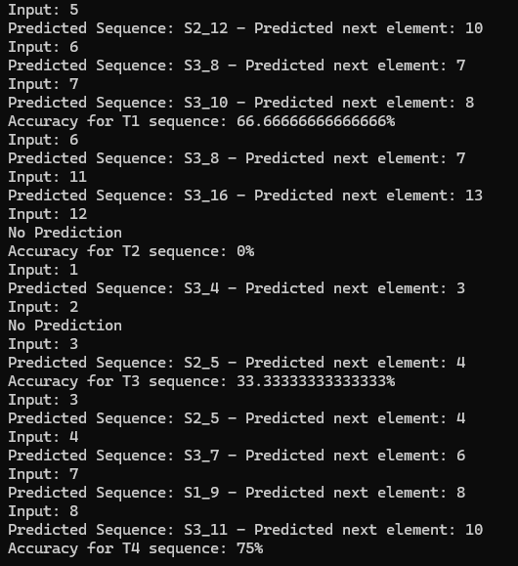
RESULTS
Among all the tests carried out in the instruction phase and forecast phase, the resemblances between patterns of the same class and various classes have clarified our results in the examples listed below.
We used Multi Sequence Learning to predict a Sequence of data points with high accuracy. The accuracy was shown to increase with the amount of cycles.

Slide 11
CONCLUSION
Future work and advancements will focus on investigating the scalability and effectiveness of the Hierarchical Temporal Memory (HTM) system in managing larger datasets and increasingly complex sequence predictions. The algorithm will be improved further with the goal of better generalizing across various data kinds, especially unstructured data, which is particularly challenging. The methodology for evaluating HTM systems against the most recent models in the state of the art within the context of their respective domains, as well as the specification of the benchmark, will all be included in this.

Slide 12
THANK YOU

